Slide 1
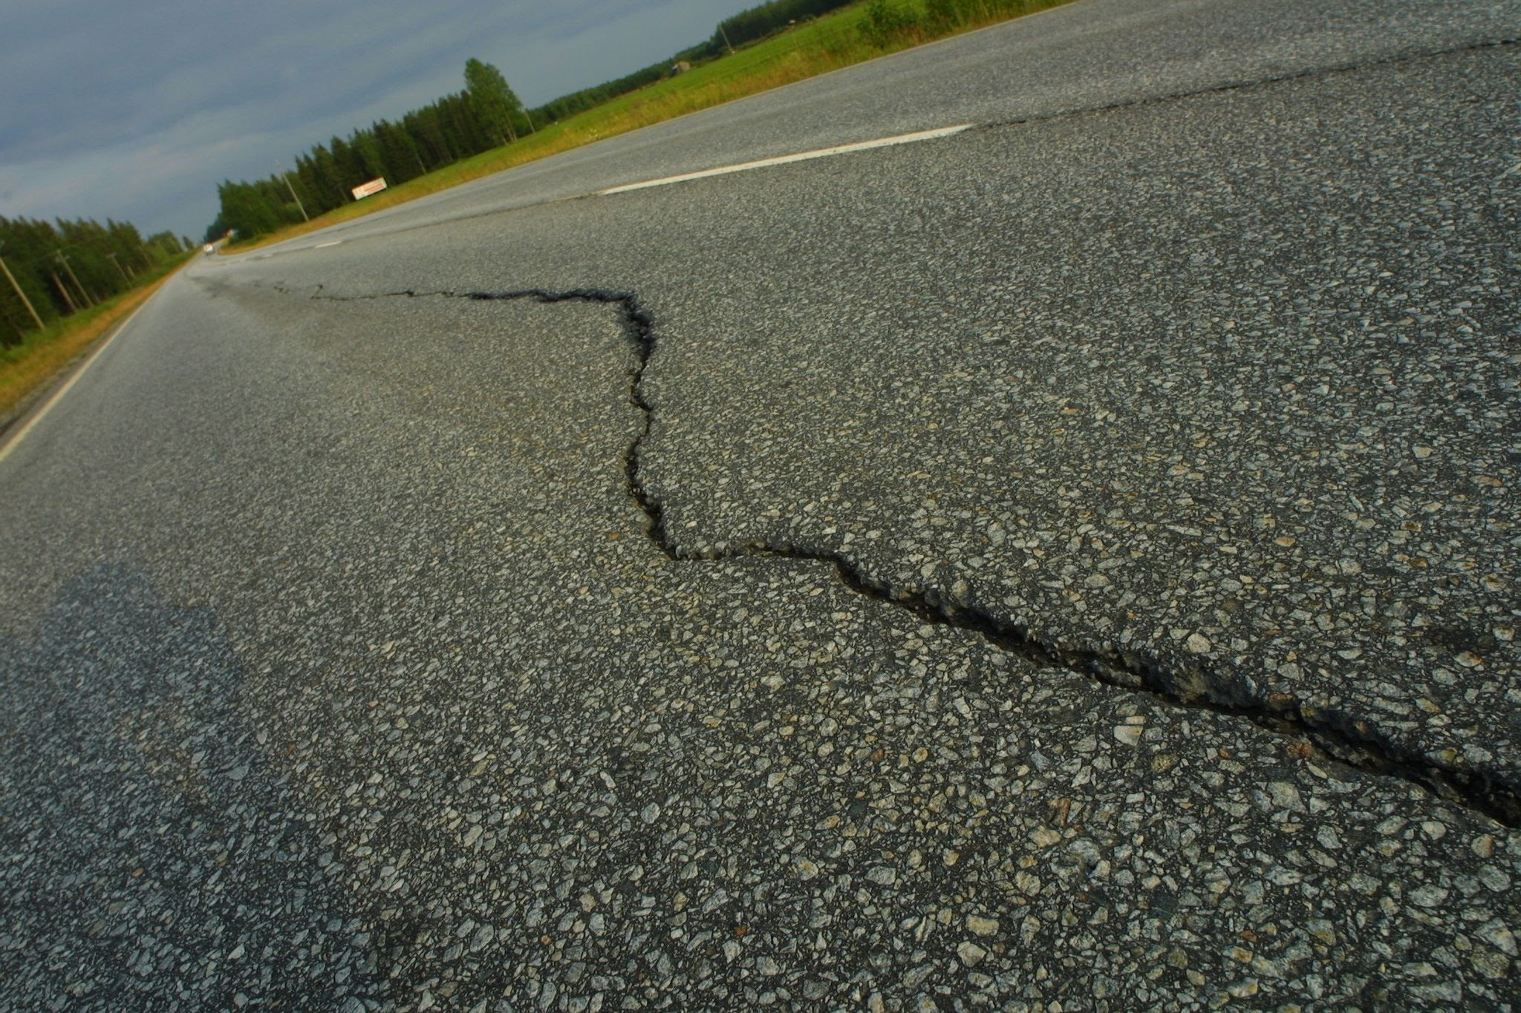
AI Road Detection: A New Era to Road Inspection
Shark Tank
Steven Clement
Jake Ilukowicz
Hudson Wilcox
COMM 205
Texas A&M University
June 29, 2026
Credit:
Notes:
Key Word Outline (KWO)
Intro
Planes, cars, golf.
Fuel efficiency
Designing complex, powerful tool

Slide 2
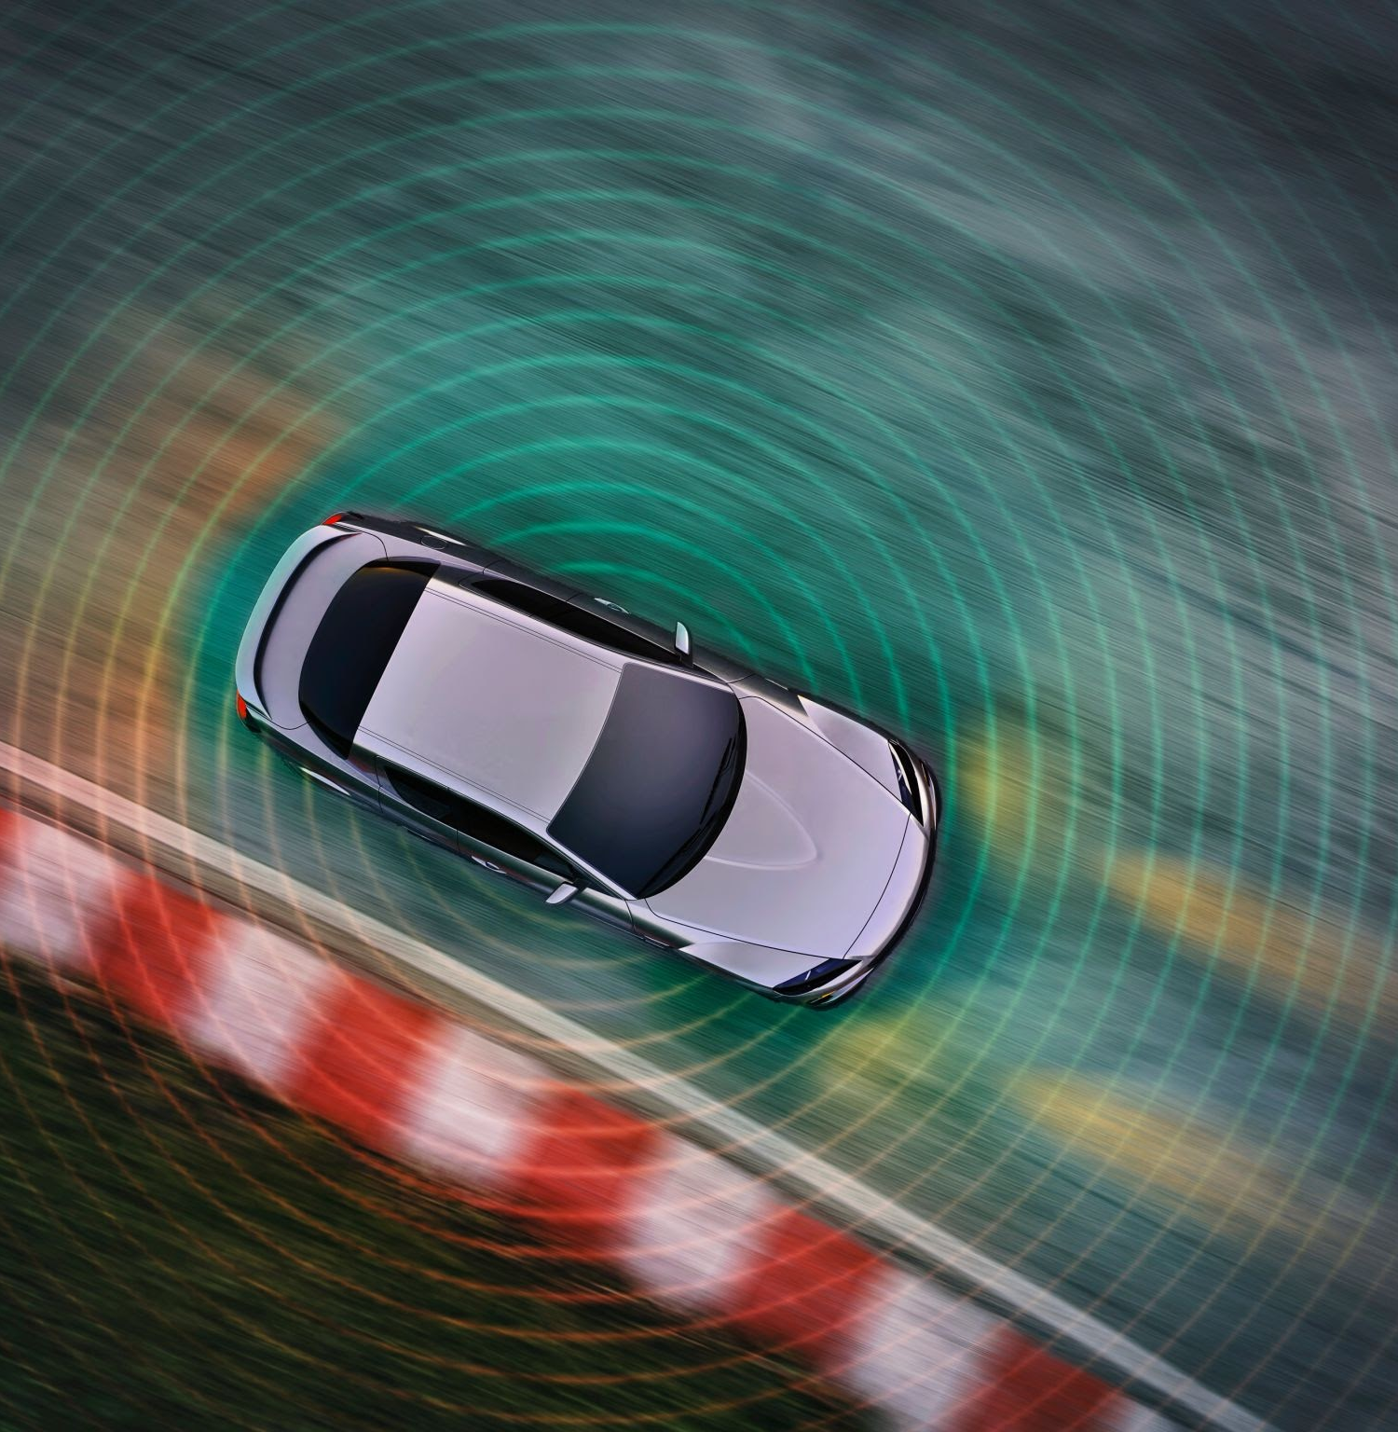

AI can use LiDAR or cameras to perceive the world
LiDAR
Camera
Notes:
MP1
Two parts

Slide 3
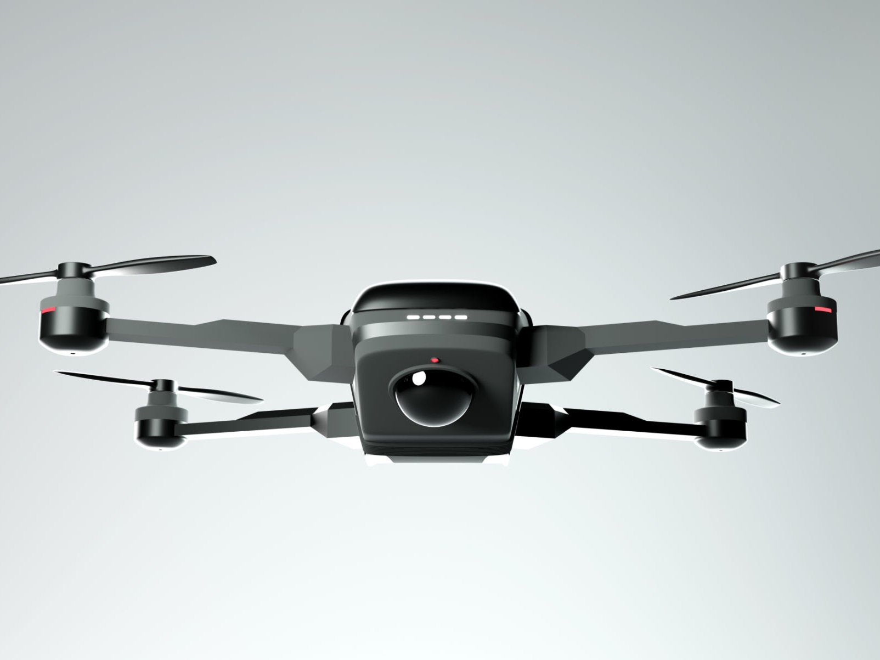
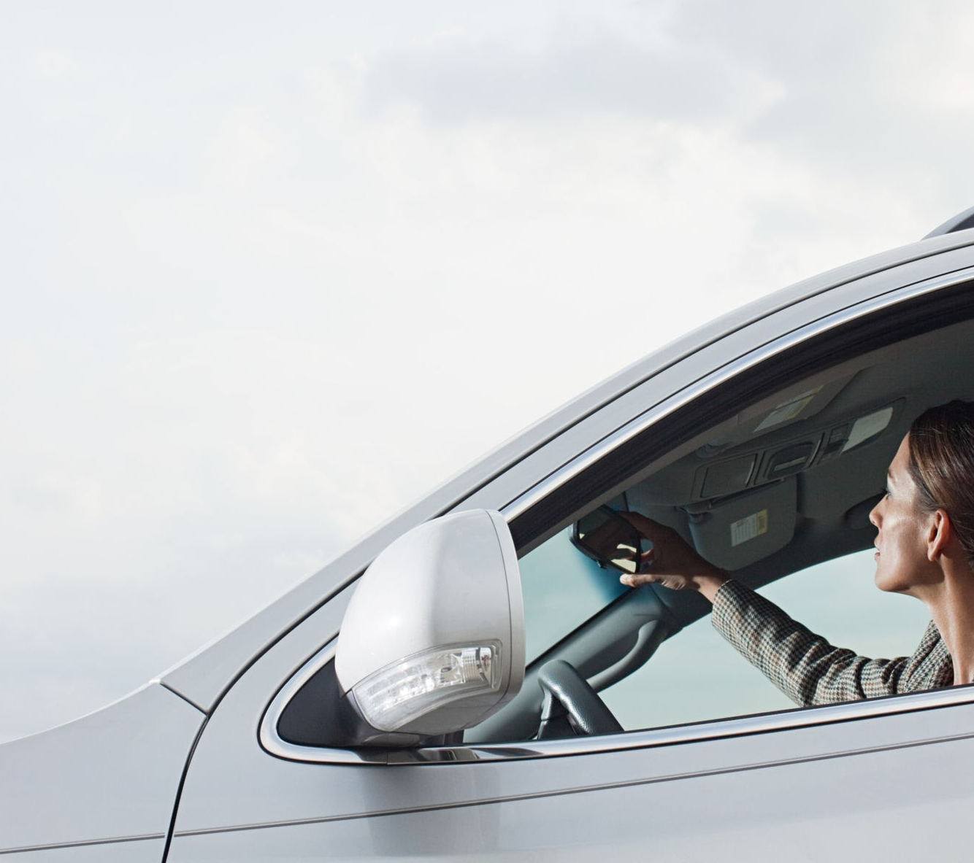
The system can be moved throughout the roadways in multiple ways
Drone
Everyday Cars
Notes:
MP1
Two parts

Slide 4

The data collected can be processed to achieve various goals
Notes:
MP2
Weight strength

Slide 5

This technology can be easily made but how can it benefit society?
Notes:
MP2
Weight strength

Slide 6
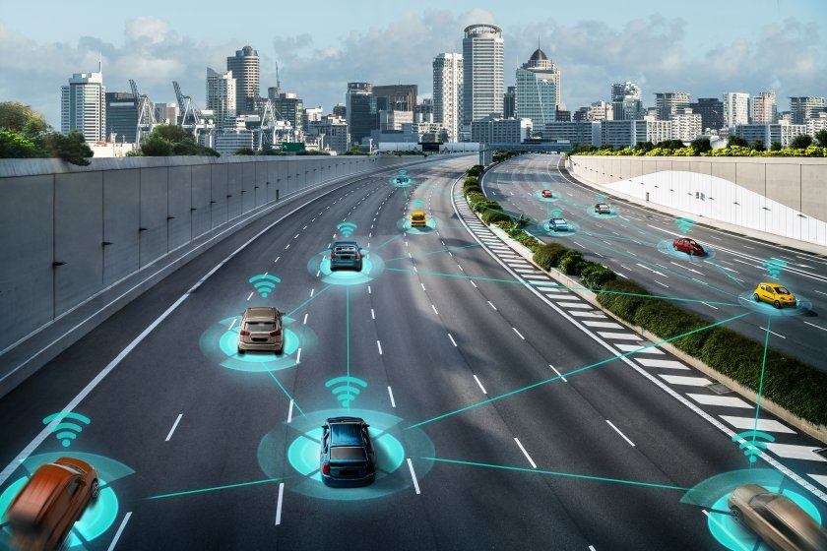
With a refined model, a trained AI can effectively cover more ground with efficiency

Slide 7
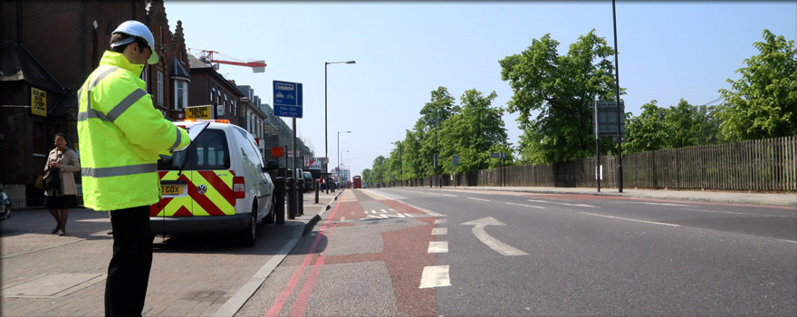
Utilizing AI-powered vehicles significantly reduces labor costs

Slide 8
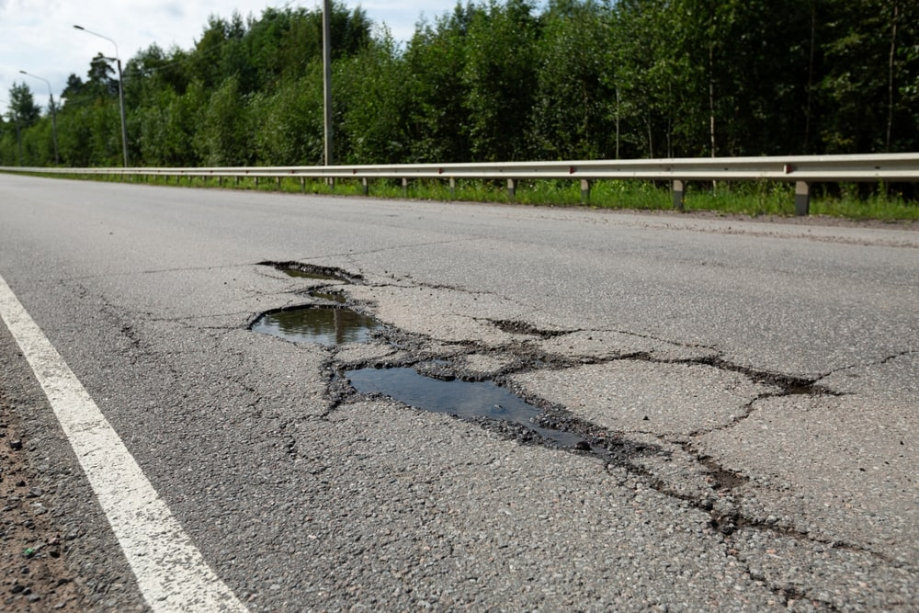
Preventative maintenance can save lives

Slide 9
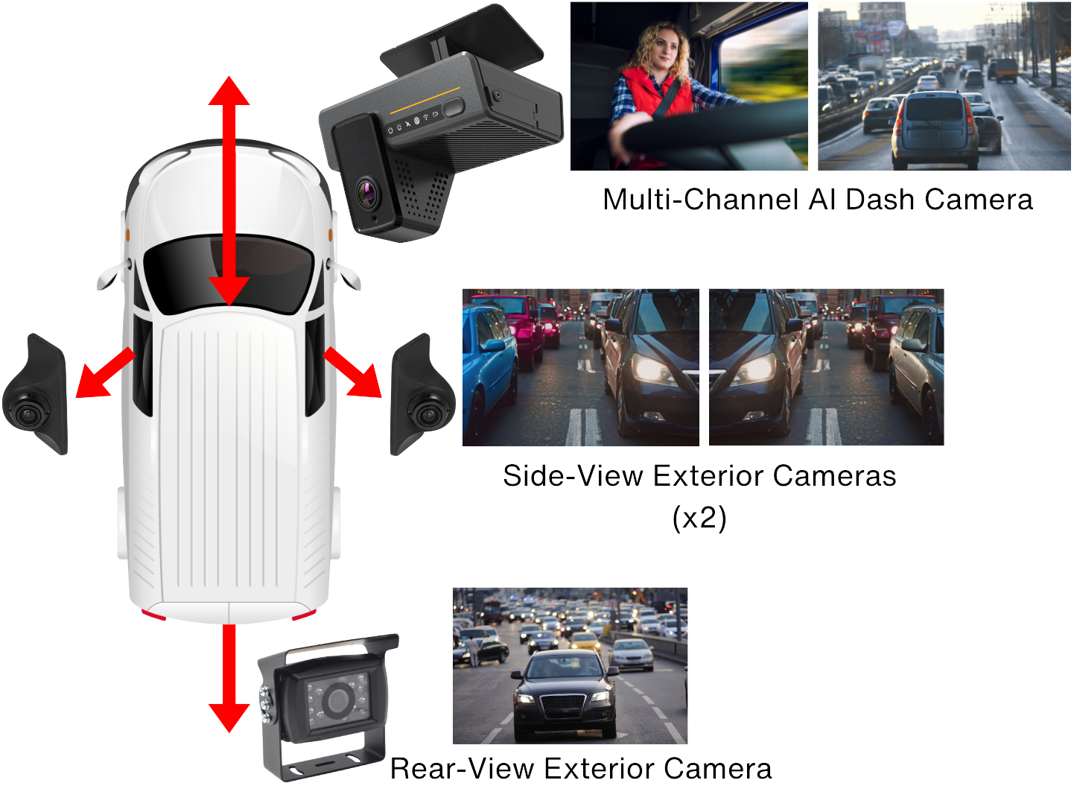
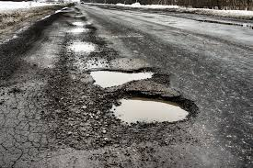
12 Month Pilot

Slide 10
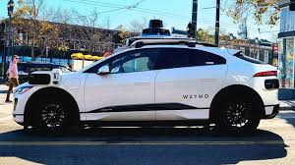
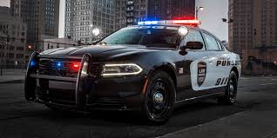
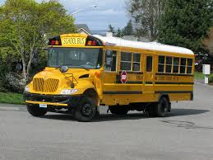
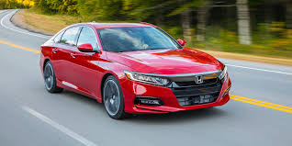
Vehicles We Have

Slide 11


Keeping Humans

Slide 12

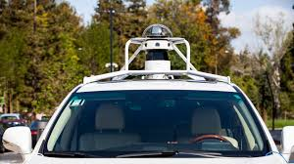
Call to Action

